Slide 1

Unemployment (Topic 3 / Chapter 28)

Slide 2
Labor Force Statistics
Produced by Bureau of Labor Statistics (BLS), in the U.S. Dept. of Labor
In Bangladeh, Bangladesh Bureau of statistics (BBS) carry survey on labor force data
Based on regular survey of 60,000 households
Based on “adult population” (16 years or older)

Slide 3
BLS divides population into 3 groups:
Employed: paid employees, self-employed, and unpaid workers in a family business
Unemployed: people who were available and not working but who have looked for work during previous 4 weeks
Not in the labor force: those who do not fit either any of the above two categories. i.e. full-time student, homemaker, or retiree
The labor force is the total # of workers, including the employed and unemployed.

Slide 4
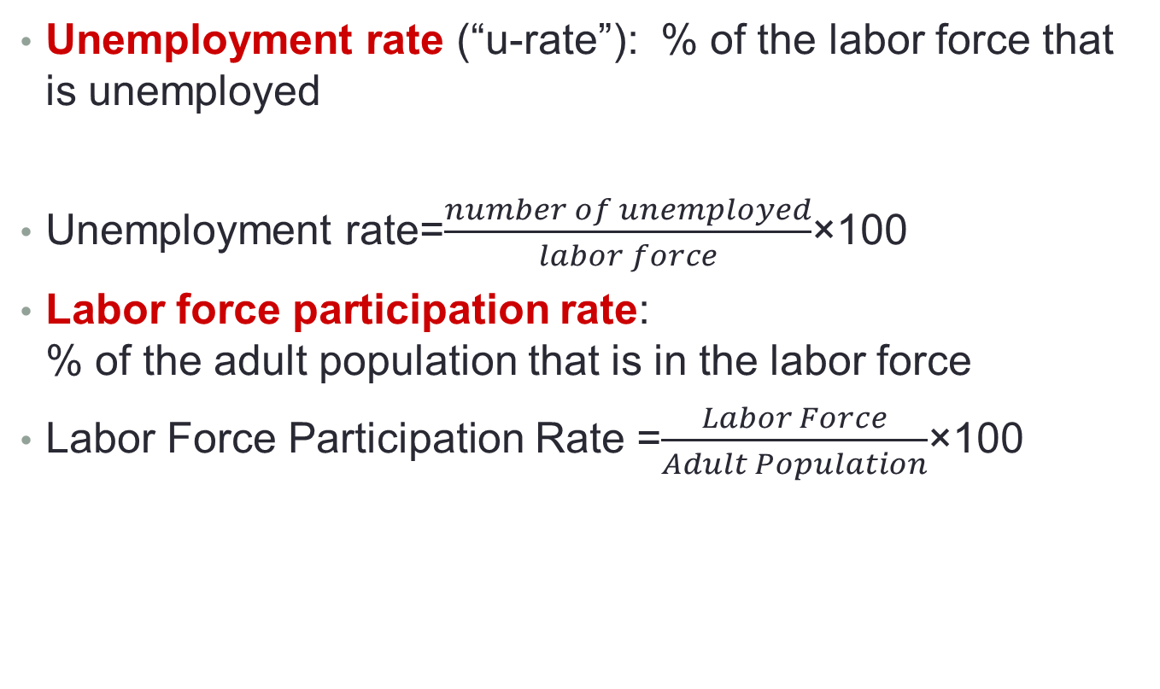
Labor Force Statistics
Unemployment rate (“u-rate”): % of the labor force that is unemployed
Unemployment rate=$\frac{number of unemployed}{labor force}$×100
Labor force participation rate: % of the adult population that is in the labor force
Labor Force Participation Rate =$\frac{Labor Force}{Adult Population}$×100

Slide 5
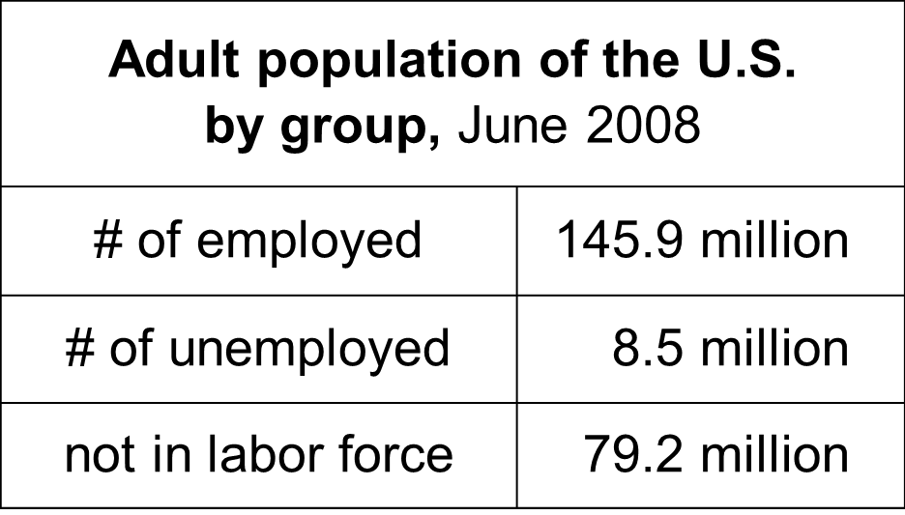
Compute the labor force, u-rate, adult population, and labor force participation rate using this data:

Slide 6
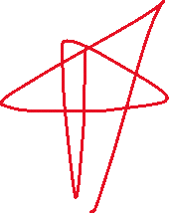
Answers
Labor force = employed + unemployed = 145.9 + 8.5 = 154.4 million
U-rate = 100 x (unemployed)/(labor force) = 100 x 8.5/154.4 = 5.5%

Slide 7




Answers
Population = labor force + not in labor force = 154.4 + 79.2 = 233.6
LF partic. rate = 100 x (labor force)/(population) = 100 x 154.4/233.6 = 66.1%

Slide 8
What Does the U-Rate Really Measure?
Most spells of unemployment are short:
Typically 1/3 of the unemployed have been unemployed under 5 weeks, 2/3 have been unemployed under 14 weeks.
Only 20% have been unemployed over 6 months.
Yet, most observed unemployment is long term.
The small group of long-term unemployed persons has fairly little turnover, so it accounts for most of the unemployment observed over time.
Knowing these facts helps policymakers design better policies to help the unemployed.

Slide 9
Natural rate and Cyclical Unemployment
There’s always some unemployment, though the u-rate fluctuates from year to year.
Natural rate of unemployment
the normal rate of unemployment around which the actual unemployment rate fluctuates
Cyclical unemployment
the deviation of unemployment from its natural rate
associated with business cycles

Slide 10
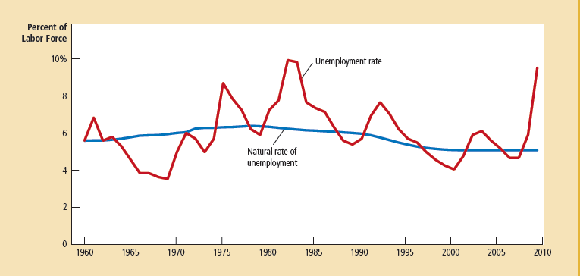
Graph

Slide 11


Explaining the Natural Rate of Unemployment
Even when the economy is doing well, there is always some unemployment, including:
Frictional unemployment
occurs when workers spend time searching for the jobs that best suit their skills and tastes
short-term for most workers
Structural unemployment
occurs when there are fewer jobs than workers
usually longer-term
Job Search :Workers have different tastes & skills, and jobs have different requirements. Job search is the process of matching workers with appropriate jobs.

Slide 12
Why Frictional Unemployment is inevitable ?
Sectoral shifts
These shifts are changes in the composition of demand across industries or regions of the country.
Such shifts displace some workers, who must search for new jobs appropriate for their skills & tastes.
The economy is always changing, so some frictional unemployment is inevitable.

Slide 13

Public Policy and Job Search
Govt. employment agencies provide information about job vacancies to speed up the matching of workers with jobs.
Public training programs aim to equip workers displaced from declining industries with the skills needed in growing industries.

Slide 14




Job Search and government policy
Unemployment insurance (UI): a govt. program that partially protects workers’ incomes when they become unemployed
UI increases frictional unemployment. To see why, recall one of the Ten Principles of Economics: People respond to incentives.
Benefits of UI:
Reduces uncertainty over incomes
Gives the unemployed more time to search, resulting in better job matches and thus higher productivity

Slide 15
Why there is unemployment?
Structural Unemployment occurs when wage is kept above equilibrium
There are three reasons for this→
Minimum-Wage Laws
Unions
Efficiency Wages

Slide 16
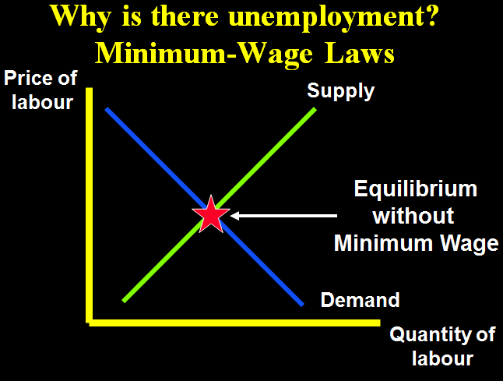
Minimum Wage Laws
When a minimum-wage law forces the wage to remain above the level that balances supply and demand, it creates a surplus of labor.

Slide 17
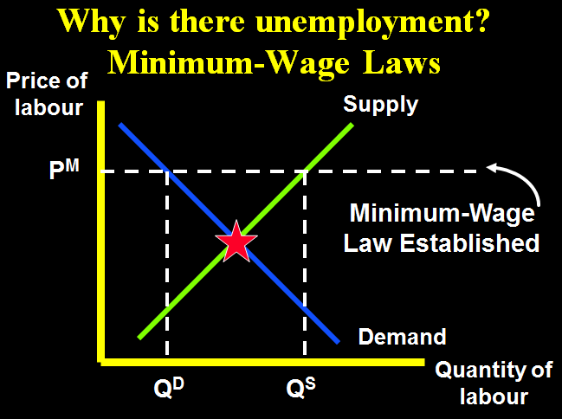
Why is there unemployment?

Slide 18
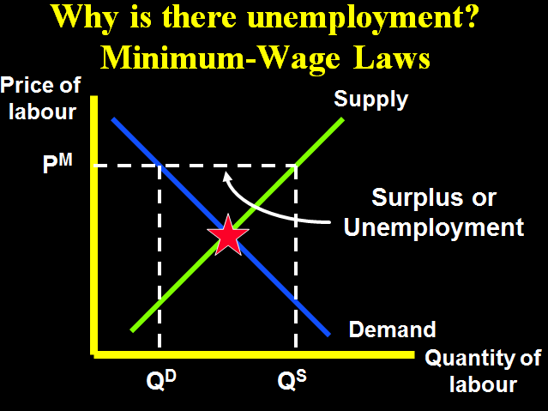
Why is there unemployment?

Slide 19
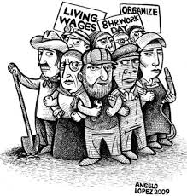



Union
A union is a worker association that bargains with employers over wages and working conditions.
A union is a type of cartel.
Unions exert their market
power to negotiate higher
wages for workers.
The typical union worker earns
20% higher wages and gets
more benefits than a nonunion
worker for the same type of work.

Slide 20





Employment situation under union
When unions raise the wage above equilibrium, quantity of labor demanded falls than quantity supply of labor and hence unemployment results.
“Insiders” → workers who remain employed, they are better off
“Outsiders”→ workers who lose their jobs, they are worse off
Some outsiders go to non-unionized labor markets, which increases labor supply and reduces wages in those markets.

Slide 21
Are unions good or bad for the economy?
Are unions good or bad?
Critics: Unions are cartels. They raise wages above equilibrium, which causes unemployment and/or depresses wages in non-union labor markets.
Advocates: Unions counter the market power of large firms, make firms more responsive to workers’ concerns

Slide 22
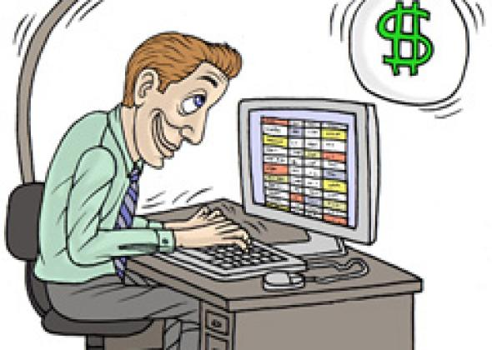
Efficiency Wages
The theory of efficiency wages:
Firms operate more efficiently if wages are above the equilibrium level.
Firms voluntarily pay above-equilibrium wages to boost worker productivity.
But in the case of unions and minimum wage laws, firms that pay above-equilibrium wages do so involuntarily.

Slide 23
Four reasons why firms might pay efficiency wages:
1. Worker health Paying higher wages allows workers to eat better, makes them healthier, more productive.
Worker turnover Hiring & training new workers is costly. Paying high wages to existing workers gives more incentive to stay, reduces turnover.
Worker quality Offering higher wages attracts better job applicants, increases quality of the firm’s workforce.
Worker effort If market wage is above equilibrium wage, there aren’t enough jobs to go around, so workers have more incentive to work not shirk.

Slide 24
Unemployment rate (1991-2013)
Notes:
Source : WDI (ILO estimation)

Slide 25
Exercises: Which of the following would be most likely to reduce frictional unemployment?
The govt. eliminates the minimum wage.
The govt. increases unemployment insurance benefits.
A new law bans labor unions.
More workers post their resumes at Monster.com, and more employers use Monster.com to find suitable workers to hire.
Sectoral shifts become more frequent.
Try to solve!!!

Slide 26
The Business Cycle
The term business cycle refers to altering rises and declines in the level of economic activity.
Decline in real GDP leads to significant increases in unemployment.
Rapid economic growth has been married by rapid inflation.

Slide 27
Phases of Business Cycle
Peak:
At a peak business activity has reached a temporary maximum.
The economy is at full employment.
Very close to full productivity.
The price level is likely to rise during this phases.

Slide 28
Phases of Business Cycle
Recession / Contraction
A period of decline in total output, income, employment and trade.
A wide spread contraction of business activity.
The price level is likely to fall.

Slide 29
Phases of Business Cycle
Trough
Output and employment bottom out at the lower levels.
The trough phase may be either short lives or quite long.

Slide 30
Phases of Business Cycle
Recovery
In the recovery phase, output and employment rise toward full employment.
The price level may begin to rise before full employment and full capacity production return.

Slide 31
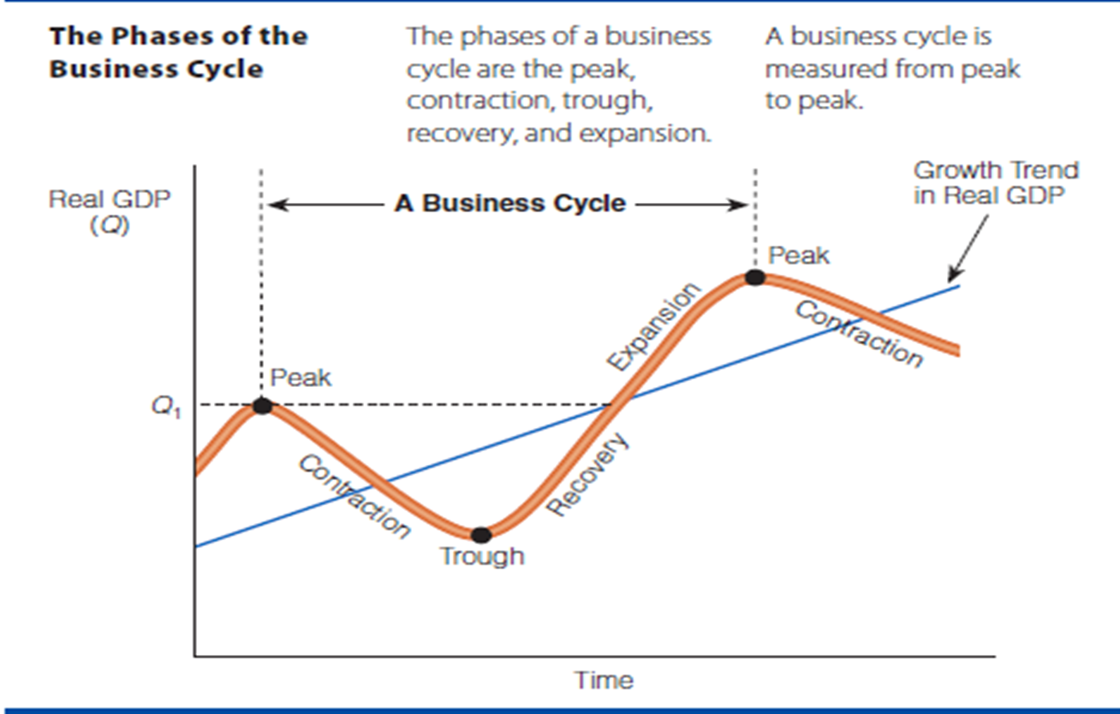
Phases of Business Cycle

